Slide 1
Hall Effect
Discovery
The physics behind it
Applications
Personal experiments
Richard Beck - Physics 141A, 2013
1

Slide 2
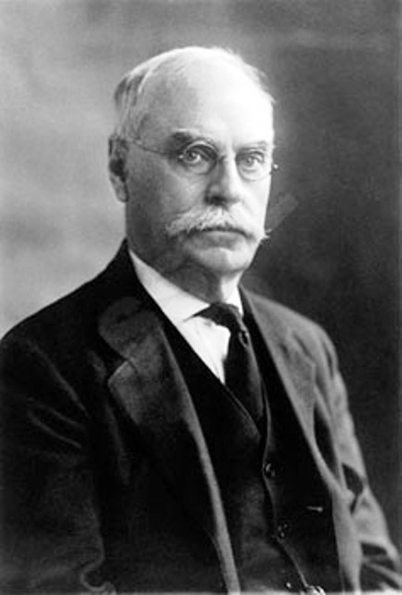

Discovery
Via Wikimedia Commons (public domain)
Richard Beck - Physics 141A, 2013

Slide 3
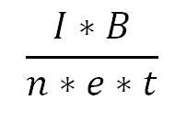
Principles
Mobile charges pressed to one side from Lorentz force, immobile charges unaltered
Creates internal electric potential, known as Hall voltage.
For simple metals, is V =
Note: t refers to the thickness of the metal along the direction of the B-field
Richard Beck - Physics 141A, 2013

Slide 4
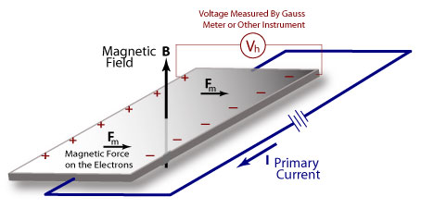
A Visual Representation
From Non-Destructive Testing (NDT) Resource Center
Richard Beck - Physics 141A, 2013

Slide 5

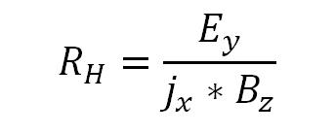
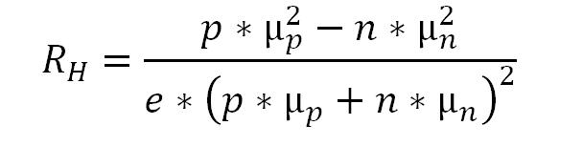
Hall Coefficient
Magnitude parameter:
In metals:
In semiconductors:
Richard Beck - Physics 141A, 2013

Slide 6
Triumphs
Classical Picture: only electrons moving in same average direction in both hole (p-type) and electron (n-type) conductivity
Opposite sign indicates that electrons in valence bands move in opposite direction than previously thought
Richard Beck - Physics 141A, 2013

Slide 7
Applications
Measurement can tell about charge carrier mobility, concentration
Conversely, knowing the above allows for sensitive measurement of an external B-field
Resistant to outside contaminants unlike optical, electromechanical testing
Richard Beck - Physics 141A, 2013

Slide 8
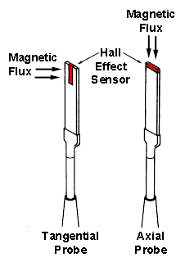
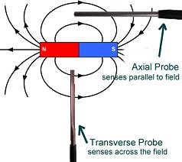
Hall Probes
Via LessEMF.com
Via the NDT Resource Center
Richard Beck - Physics 141A, 2013

Slide 9
Rotation Sensing
Hall Effect sensors capable of switching very fast, does not distort like capacitative or inductive sensors
Contactless sensing
Richard Beck - Physics 141A, 2013

Slide 10
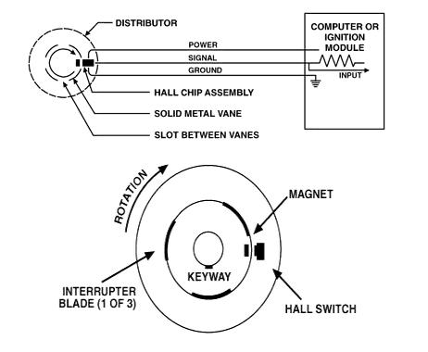
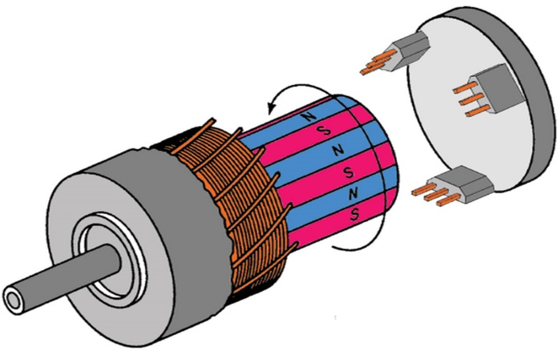
In Cars
Used expansively in rotating systems
Anti-lock brakes, motor feedback, ignition
Via Power Systems Design, Ltd.
Via Draper, 2005
Richard Beck - Physics 141A, 2013

Slide 11
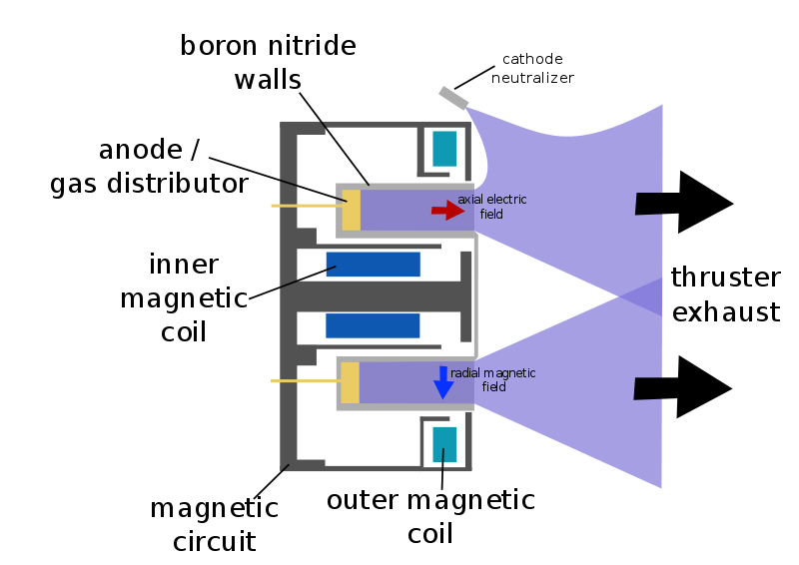
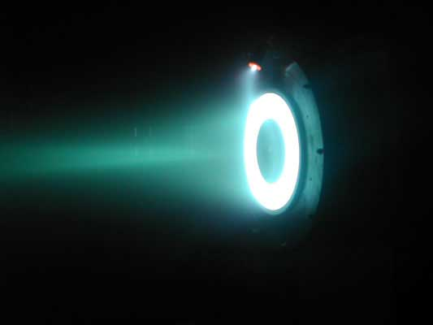
In Space
Hall Effect thruster
Trap electrons in a magnetic field, electrons ionize propellant, creates thrust
Richard Beck - Physics 141A, 2013

Slide 12
New Discoveries
QuantumHall Effect
Spin Hall Effect
Anomalous Hall Effect
Richard Beck - Physics 141A, 2013

Slide 13

Quantum Hall Effect
Quantization of normal Hall Effect
Seen at low temperature, high magnetic field
Very precise, magnitude determined by Landau levels and electron interaction
Richard Beck - Physics 141A, 2013

Slide 14
Spin Hall Effect
Separation of electron spins in current-carrying object, no magnetic field needed
Predicted in 1971, observed in 2004 via emission of circularly polarized light
Universal, present in metals and semiconductors at high and low temperature
Richard Beck - Physics 141A, 2013

